Slide 1
Lambdas
Lecture 10

Slide 2
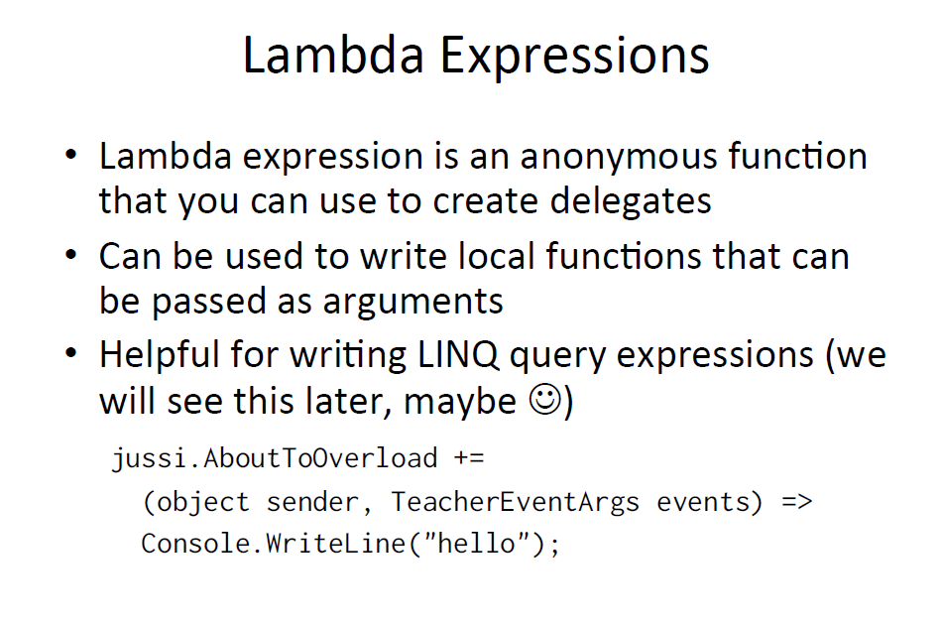

Slide 3
LAMBDA WITHOUT PARAMETERS
The basic syntax
ArgumentsToProcess => StatementsToProcessThem
WHERE ”=>” indicates that the full statement is lambda Expression

Slide 4
EXAMPLE
// "i" is our parameter list.
// "(i % 2) == 0" is our statement set to process "i".
List<int> evenNumbers = list.FindAll(i => (i % 2) == 0);
WE ALSO CAN EXPLICITLY STATE THE PARAMETER
List<int> evenNumbers = list.FindAll((int i) => (i % 2) == 0);
OR
List<int> evenNumbers = list.FindAll((i) => (i % 2) == 0);

Slide 5
Processing Arguments Within Multiple Statements
List<int> evenNumbers = list.FindAll((i) =>
{
Console.WriteLine("value of i is currently: {0}", i);
bool isEven = ((i % 2) == 0);
return isEven;
});

Slide 6
Lambda Expressions with Multiple Parameters
SimpleMath m = new SimpleMath();
m.SetMathHandler((msg, result) =>
{
Console.WriteLine("Message: {0}, Result: {1}", msg, result);
});

Slide 7
Lambda Expression with Zero Parameters
// Prints "Enjoy your string!" to the console.
VerySimpleDelegate d = new VerySimpleDelegate( () => {
return "Enjoy your string!";
} );
Console.WriteLine(d());

Slide 8
Variable Scope in Lambda
Lambdas can refer to outer variables (see Anonymous Methods (C# Programming Guide)) that are in scope in the method that defines the lambda function, or in scope in the type that contains the lambda expression. Variables that are captured in this manner are stored for use in the lambda expression even if the variables would otherwise go out of scope and be garbage collected. An outer variable must be definitely assigned before it can be consumed in a lambda expression.

Slide 9
RULES
A variable that is captured will not be garbage-collected until the delegate that references it becomes eligible for garbage collection.
Variables introduced within a lambda expression are not visible in the outer method.
A lambda expression cannot directly capture a ref or out parameter from an enclosing method.
A return statement in a lambda expression does not cause the enclosing method to return.
A lambda expression cannot contain a goto statement, break statement, or continue statement that is inside the lambda function if the jump statement’s target is outside the block. It is also an error to have a jump statement outside the lambda function block if the target is inside the block.

Slide 10
EXAMPLE
delegate bool D();
delegate bool D2(int i);
class Test
{
D del;
D2 del2;
public void TestMethod(int input)
{
int j = 0;
// Initialize the delegates with lambda expressions.
// Note access to 2 outer variables.
// del will be invoked within this method.
del = () => { j = 10; return j > input; };
// del2 will be invoked after TestMethod goes out of scope.
del2 = (x) => {return x == j; };
// Demonstrate value of j:
// Output: j = 0
// The delegate has not been invoked yet.
Console.WriteLine("j = {0}", j);
// Invoke the delegate.
bool boolResult = del();
// Output: j = 10 b = True
Console.WriteLine("j = {0}. b = {1}", j, boolResult);
}

Slide 11
static void Main()
{
Test test = new Test();
test.TestMethod(5);
// Prove that del2 still has a copy of
// local variable j from TestMethod.
bool result = test.del2(10);
// Output: True
Console.WriteLine(result);
Console.ReadKey();
}
}

Slide 12
Action<T>, Func<TResult> and Predicate<T> Delegate
Special GENERIC DELEGATES that are designed to simplify Life of Programmers who work with collections

Slide 13
DEFINITIONS
Predicate – delegate that takes parameter(s), runs code using the parameter(s) and always returns a Boolean
Func – delegate that takes parameter(s), runs code using the parameter(s) and returns the type that you specify
Action – delegate that takes parameter(s), runs code using the parameter(s) and doesn’t return anything

Slide 14
EXAMPLE OF ACTION
static void CalculateAge(Employee emp)
{
emp.Age = DateTime.Now.Year - emp.Birthday.Year;
}
Action<Employee> empAction = new Action<Employee>(CalculateAge);
employees.ForEach(empAction);
foreach (Employee e in employees)
{
Console.WriteLine(e.Age);
}

Slide 15
SAME EXAMPLE USING LAMBDA
employees.ForEach(emp => emp.Age = DateTime.Now.Year - emp.Birthday.Year);
foreach (Employee e in employees)
{
Console.WriteLine(e.Age);
}

Slide 16
INITIALIZATION OF COLLECTION USING ACTION
nt[] a = Enumerable.Repeat(-1, 10).ToArray();
int[] b = Enumerable.Range(0, 10).ToArray();
int[] c = Enumerable.Range(0, 10).Select(i => 100 + 10 * i).ToArray();

Slide 17
EXAMPLE OF PREDICATE
public class InventoryItem
{
public int ID { get; set; }
public int NumberInStock { get; set; }
public double UnitCost { get; set; }
}

Slide 18
What if we have a collection and want to find element
public InventoryItem FindInventoryForeach(int inventoryID)
{
foreach (InventoryItem item in _inventoryList)
{
if (item.ID == inventoryID)
return item;
}
return null;
}

Slide 19
Using delegate we can use Extension method of Collection - Find
public InventoryItem FindInventoryPredicateDelegate(int inventoryID)
{
Predicate<InventoryItem> pred = delegate(InventoryItem item)
{
return item.ID == inventoryID;
};
return _inventoryList.Find(pred);
}

Slide 20
OR EVEN WRITE DIRECTLY
public InventoryItem FindInventoryDelegate(int inventoryID)
{
return _inventoryList.Find(delegate(InventoryItem item) {
return item.ID == inventoryID;
});
}

Slide 21
USING LAMBDA AND GENERIC PREDICATE
public InventoryItem FindInventoryPredicateLambda(int inventoryID)
{
Predicate<InventoryItem> pred =
item => item.ID == inventoryID;
return _inventoryList.Find(pred);
}

Slide 22
AND EVEN CLEANER WAY
public InventoryItem FindInventory(int inventoryID)
{
return _inventoryList.Find(item => item.ID == inventoryID);
}

Slide 23
TRY YOURSELF WITH DIFFERENT METHODS
FindAll – returns a List of objects that meet the condition
RemoveAll – removes the objects that meet the condition
Exists – does the object exist that meets the condition?
FindLast – returns the last object that meets the condition
For the full list, see http://msdn.microsoft.com/en-us/library/s6hkc2c4.aspx

Slide 24
EXAMPLE OF FUNCTION
public List<InventoryItem> FindItemsWhereLessThanCostFuncDelegate(double unitCost)
{
Func<InventoryItem, bool> whereFunc = delegate(InventoryItem item)
{
return item.UnitCost < unitCost;
};
return _inventoryList.Where(whereFunc).ToList<InventoryItem>();
}

Slide 25
TRY TO SIMPLIFY WITH LAMBDA
public List<InventoryItem> FindItemsWhereLessThanCostFuncLambda(double unitCost)
{
Func<InventoryItem, bool> whereFunc =
item => item.UnitCost < unitCost;
return _inventoryList.Where(whereFunc).ToList<InventoryItem>();
}

Slide 26
PASSING LAMBDA DIRECTLY
public List<InventoryItem> FindItemsWhereLessThanCost(double unitCost)
{
return _inventoryList.Where(item => item.UnitCost < unitCost) .ToList<InventoryItem>();
}

Slide 27
TRY YOURSELF
FirstOrDefault – returns the first item that meets the condition or a default value (for an object, the default value is null)
LastOrDefault – returns the last item that meets the condition or a default value (for an object, the default value is null)
First – returns the first item that meets the condition
For the full list see http://msdn.microsoft.com/en-us/library/s6hkc2c4.aspx

